Slide 1


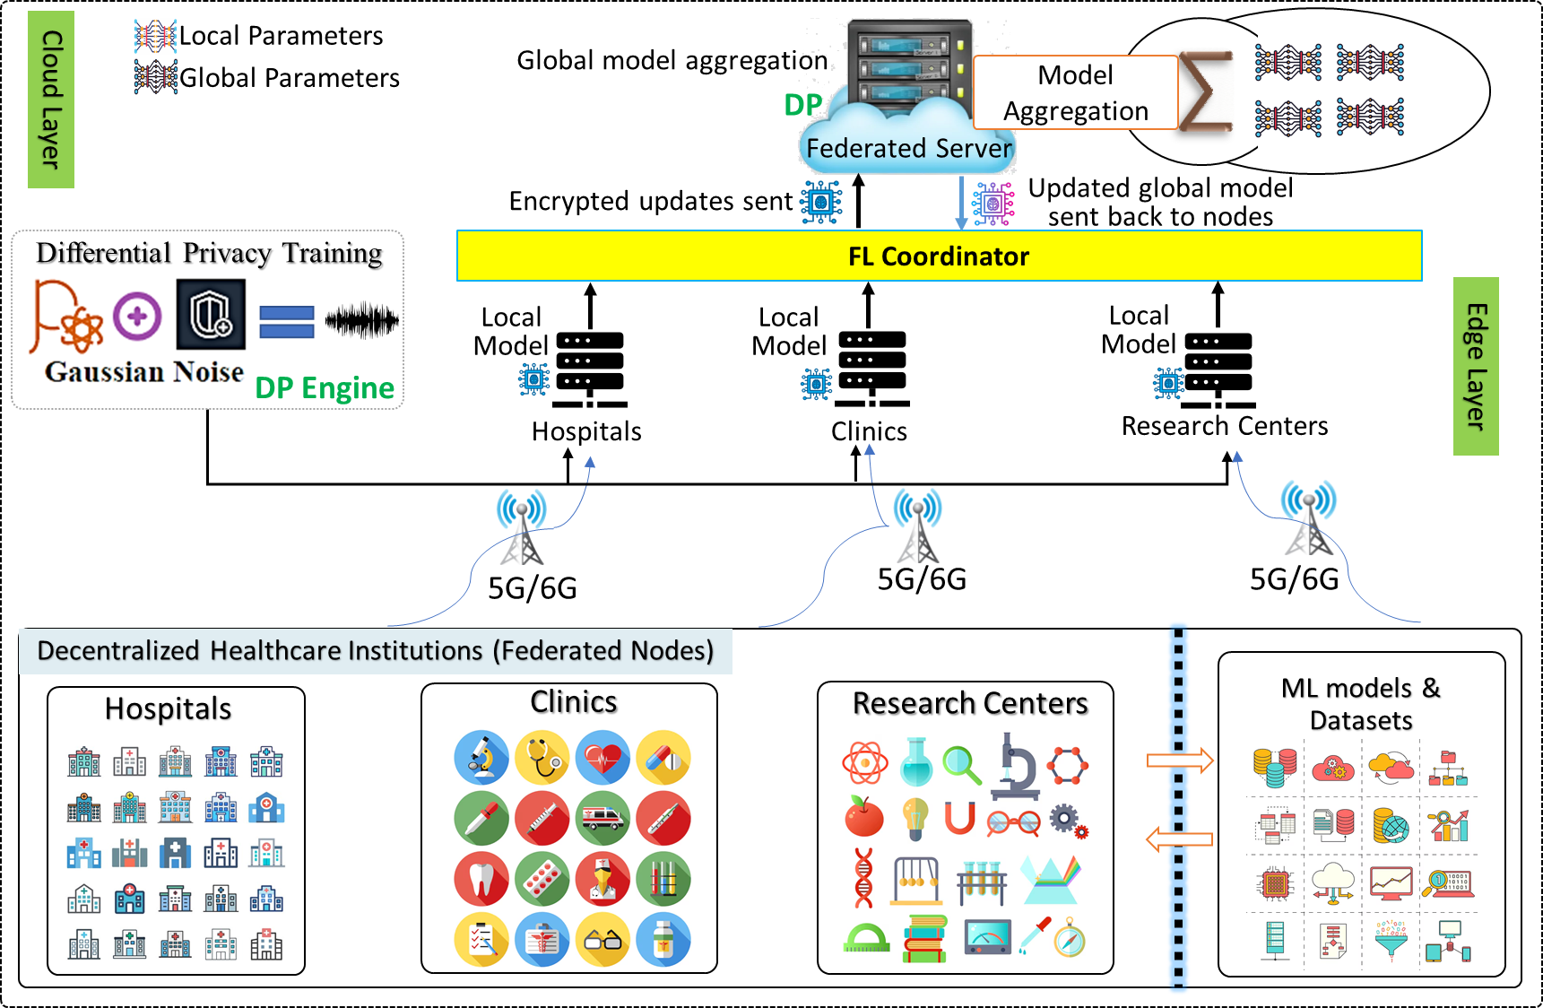
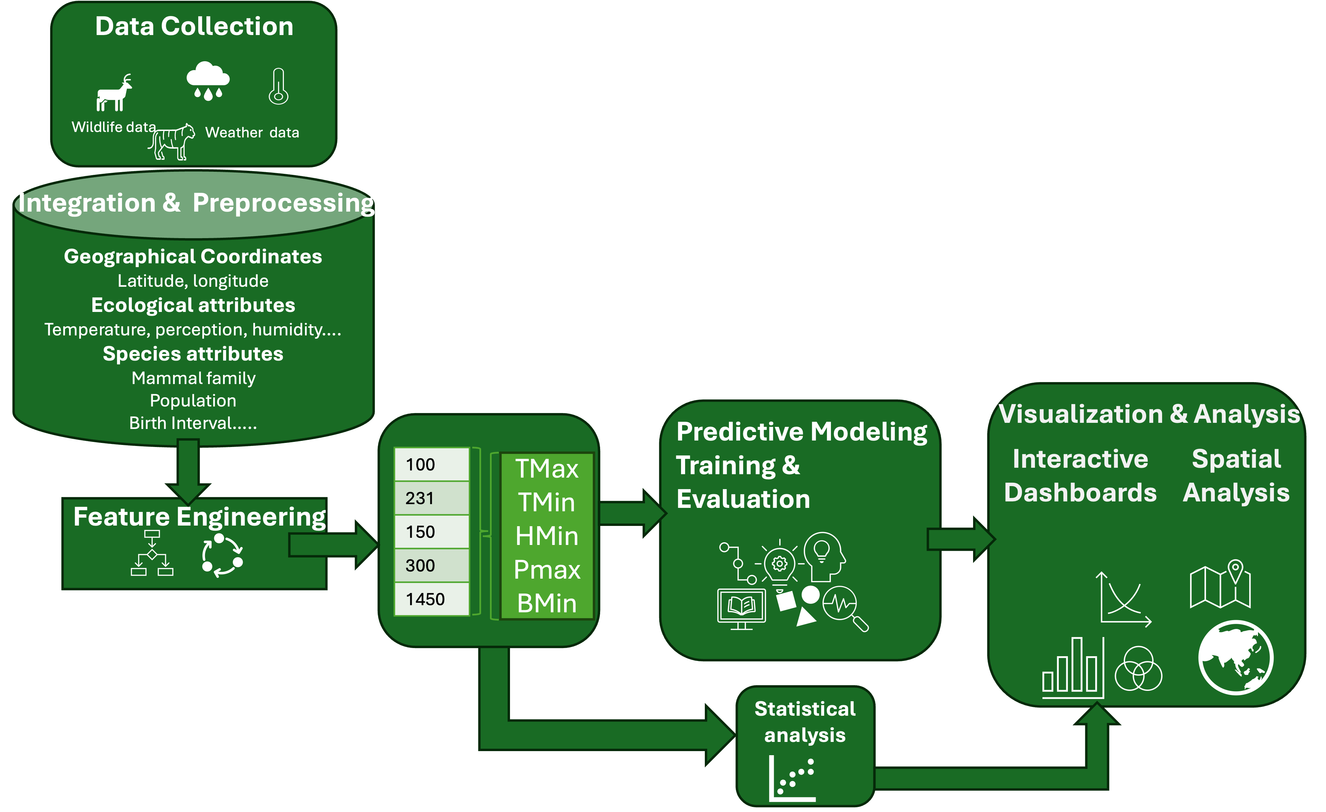
Student Research
Loni Taylor
Biomedical Data Sciences, Applied Computational Science and Data Science, Meharry Medical College
^{(lotaylor23@mmc.edu)}
INTRODUCTION & MOTIVATION
Research Areas
Project 3
Area | Projects
ENVIRONMENTAL RESEARCH & AI | EcoPredictML: Understanding and Predicting Ecosystem Disruption Impacting Mammals through Machine Learning Models
The
Successfully illustrated the preliminary correlation analysis and feature distribution employed during the initial phase.
The
METHODOLOGY (System Model)
Modeling the interactions between animals and ecosystem, such as mammals, to understand population dynamics -> Using complex computational simulations to predict long-term environmental changes and impact on population dynamics.
Project 1: Proposed System Model Architecture.
Author Bios
Project 1 -> Loni Taylor: Experience in education, project management, computational analysis, data systems engineering, and technology focused on driving digital transformation and using AI/ML in technology integration. Specializes in strategic planning, systems integration, and innovative tech solutions. Loni is currently a Ph.D. candidate in Biomedical Data Sciences at Meharry Medical College with a B.S. and a M.S. degree in Computer Science. Her research focuses on task automation and adaptive learning.
Project 2: Workflow of the EcoPredictML Framework.
METHODOLOGY (System Workflow)
REFERENCES
Project 1 -> Machine Learning: Data Collection, Integration and Preprocessing -> Feature Engineering for Machine Learning Models -> Machine Learning, Atmospheric Variances and Mammal Behavior Mapping -> Statistical Analysis -> Visualization.
Project 1
Gianpaolo Coro, Pasquale Bove, Ilaria Baneschi, Andrea Bertini, Lorenzo Calvisi, and Antonello Provenzale. Climate change effects on animal presence in the massaciuccoli lake basin. Ecological informatics, 81(July 2024):102644–102644, May 2024
Project 3
Project 3: After

